Slide 1
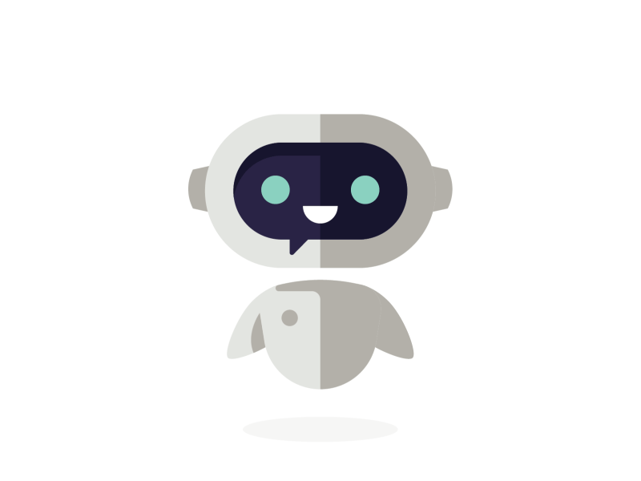
Conversational UI? Conversational AI? What’s all the fuss about?

Slide 2
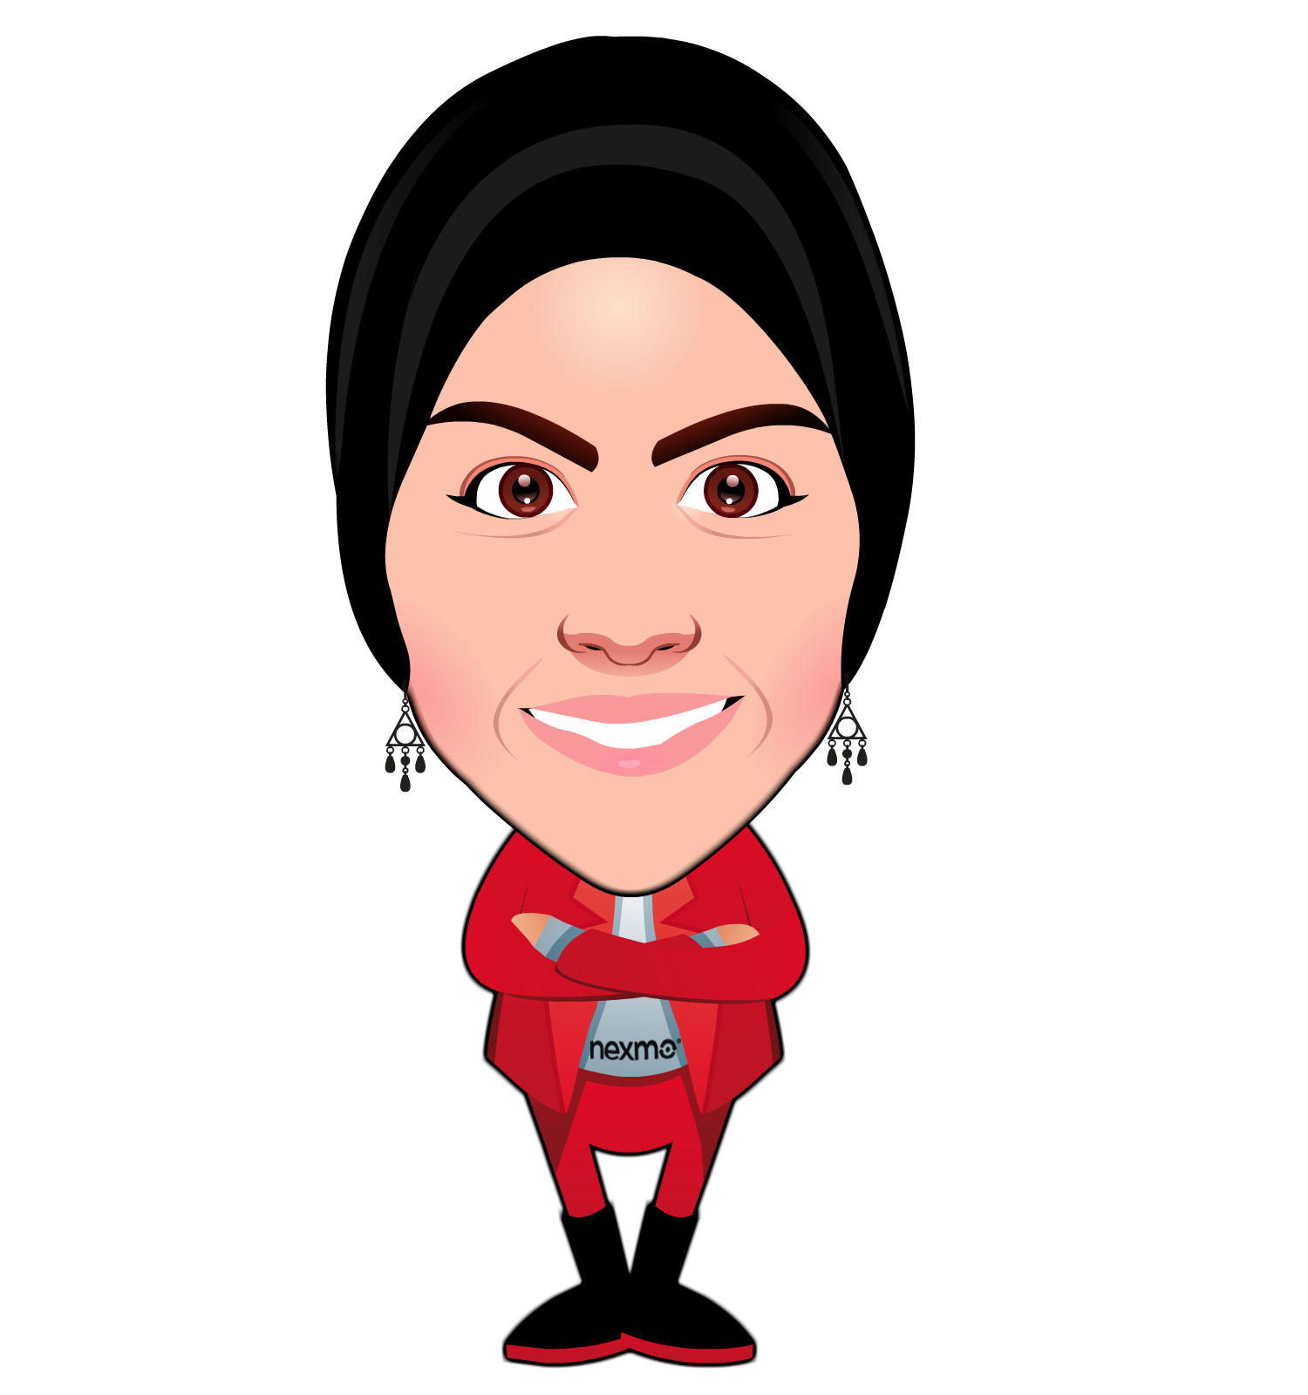
@Rabeb_Othmani
Developer advocate
Favourite teammate of everyone on the @NexmoDev team
Women Who Code
Not famous yet

Slide 3
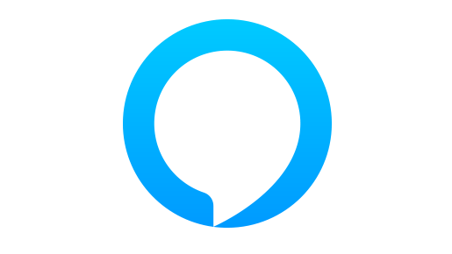
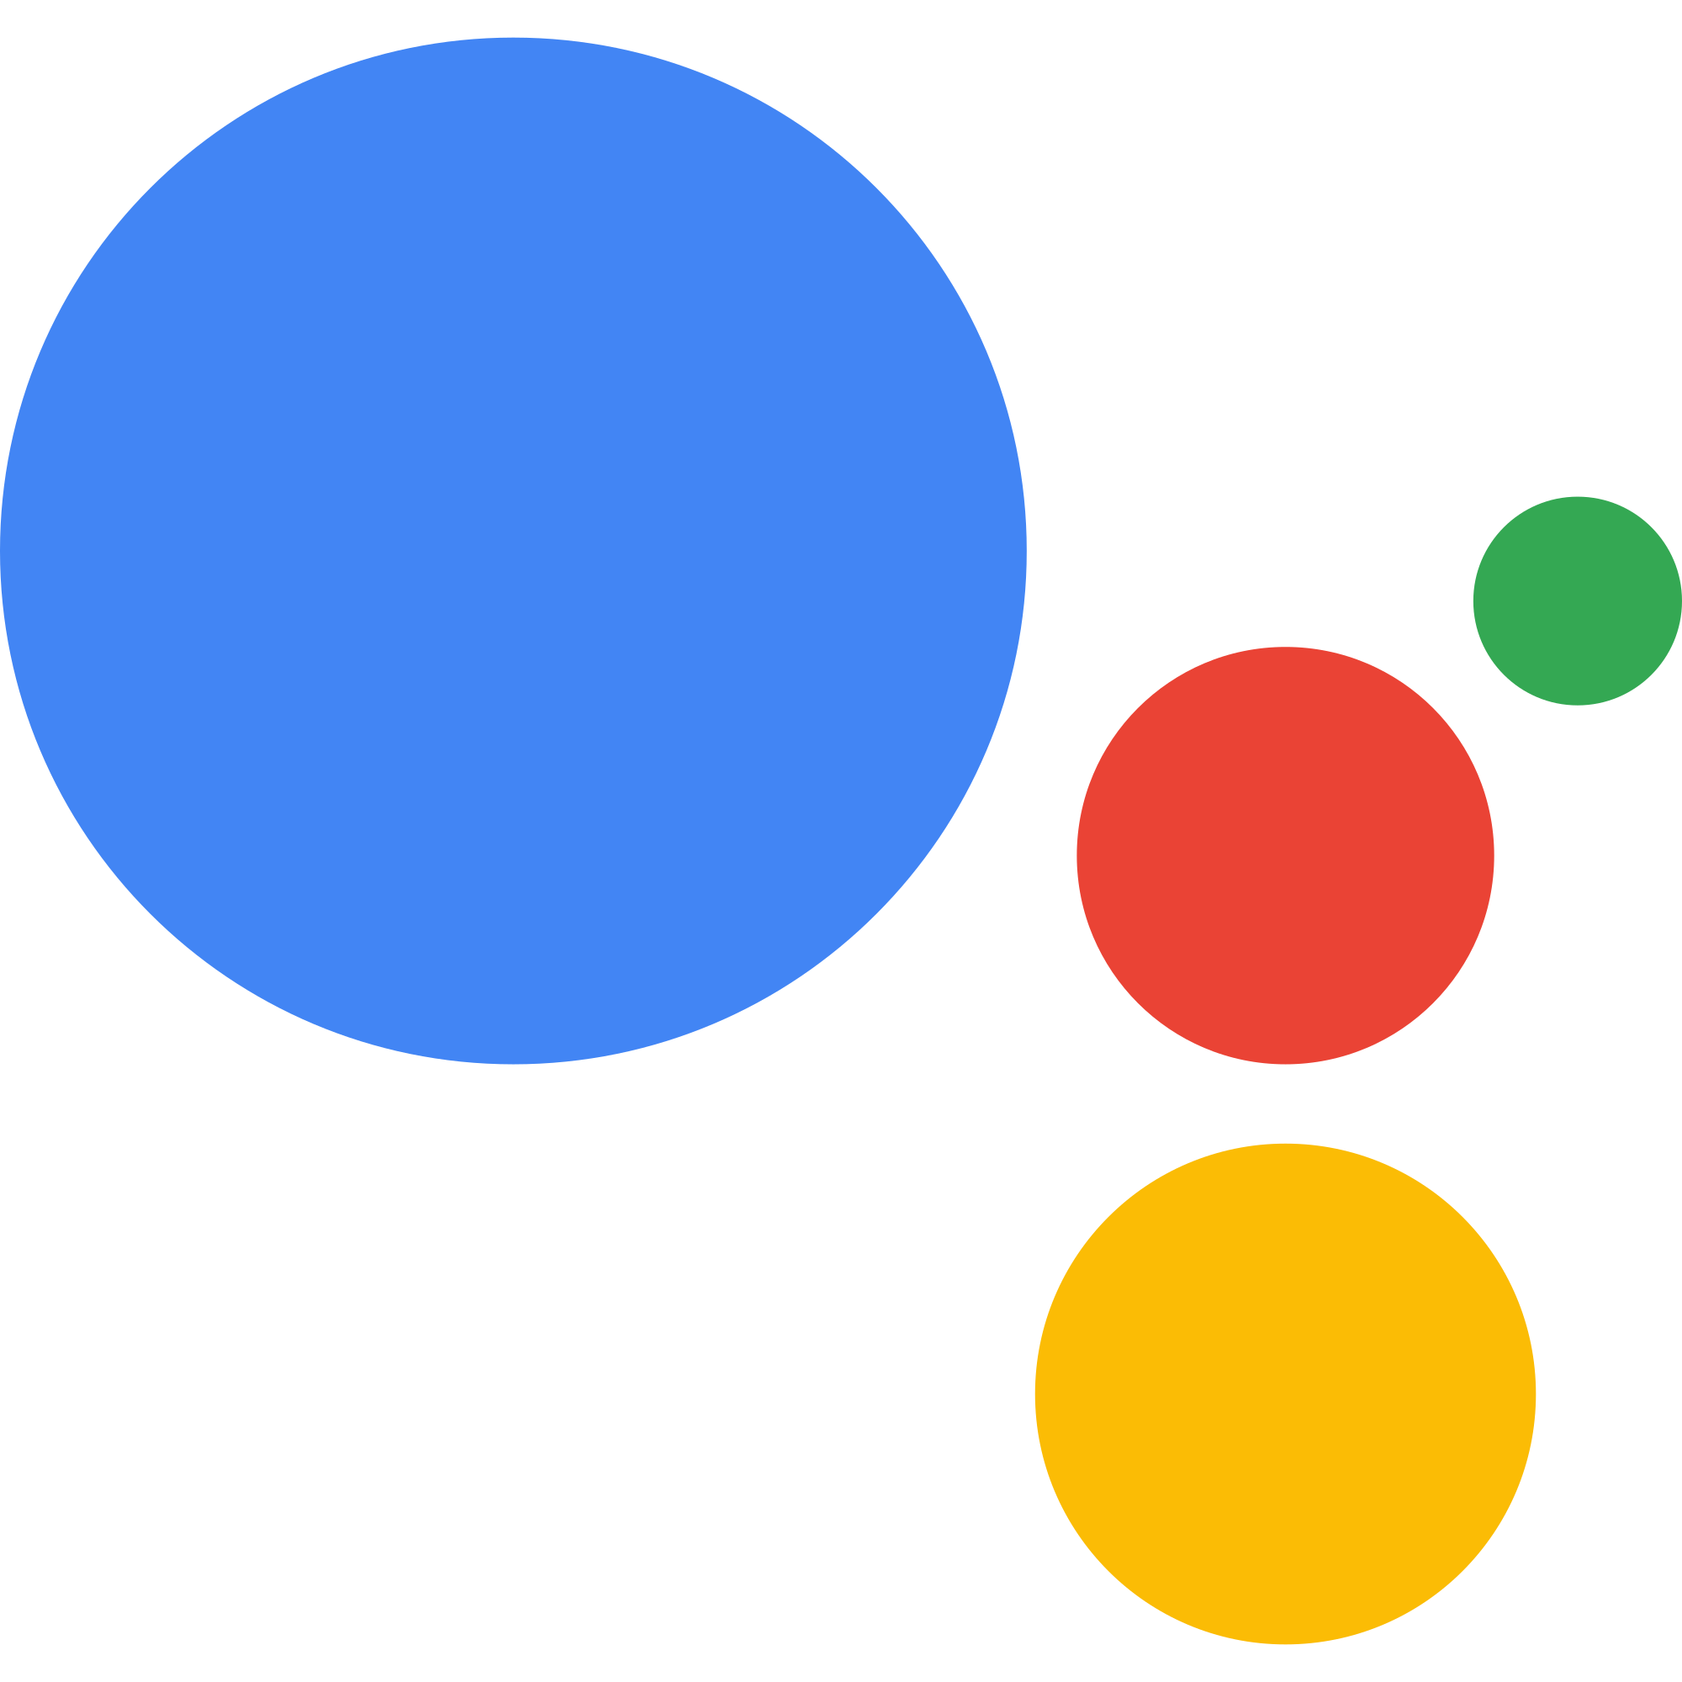


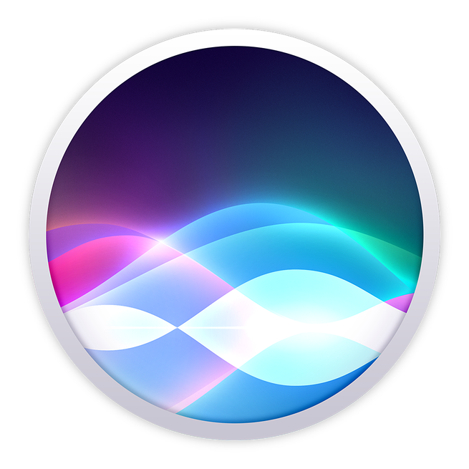
The Rise of Bots

Slide 4
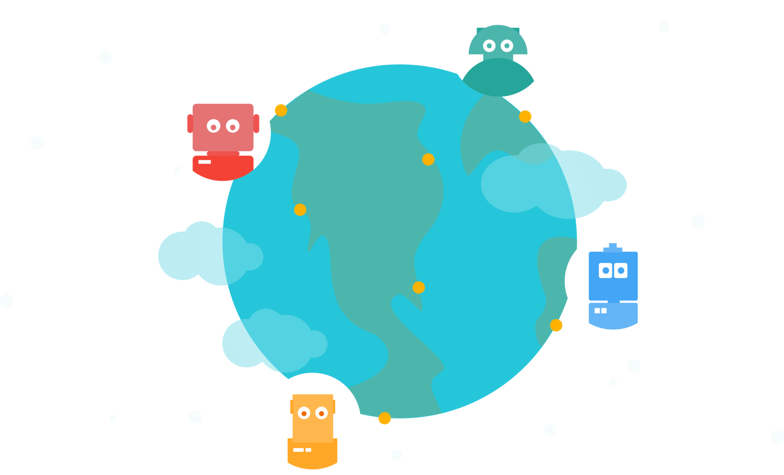
~45% of end users prefer chatbots as the primary mode of communication for customer service inquires. source: Grand View Research report
by 2019, the voice recognition market will be a $601 million industry. source: Technavio
Consumer Intelligence Research Partners (CIRP) estimates that 8.2 million people own an Amazon Echo device.

Slide 5

Book me a flight
Play music
How did she survive before ??!!
I’d like to order a pizza
What’s the weather in Stockholm today?
I have a problem logging in to my account

Slide 6
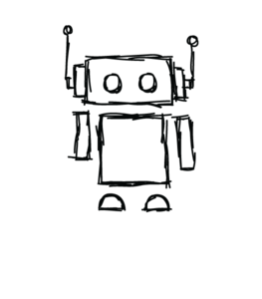
The Interface of The Future
Applications that talk.
Applications that converse with the user on human terms.
Applications that understand context.
Applications that get smarter over time.

Slide 7
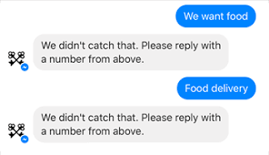
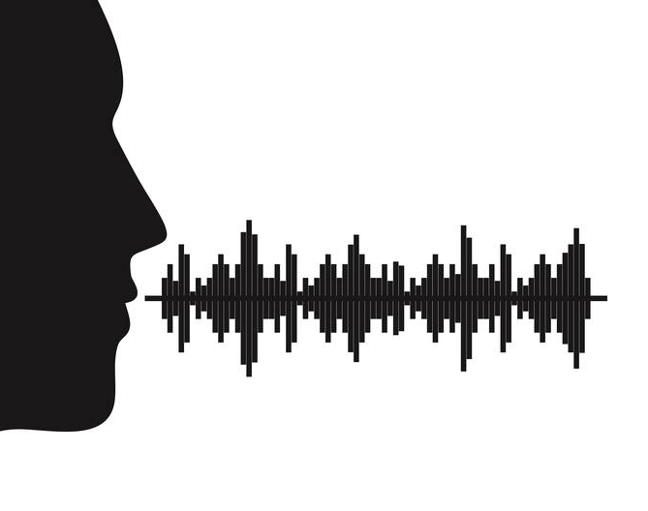
Text based conversational interfaces
A mix of both
Voice based conversational interfaces

Slide 8

Voice as a Primary Conversational Interface
Frictionless experience
A natural mean of interaction
Fast, simple & everywhere

Slide 9

More than recognising voice or text
Intelligent interfaces
A natural-language understanding of intentions behind those words.
artificial intelligence reasoning
contextual awareness.

Slide 10

Challenges & Considerations
Does it solve a real problem?
Is it smart enough?
Does it meet the needs of the user?
Is the natural language processing advanced enough?

Slide 11
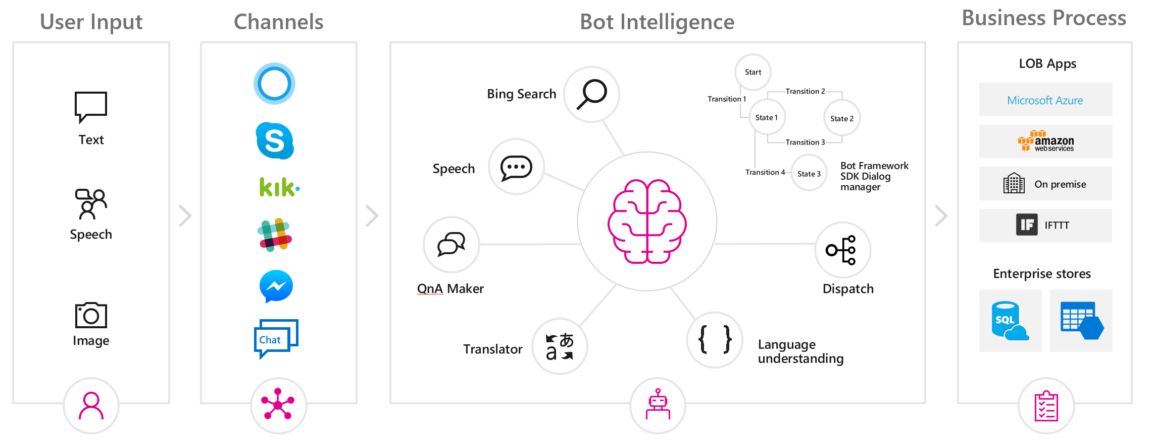
Microsoft Conversational AI
Slide courtesy of Microsoft

Slide 12

LUIS: Language Understanding Intelligent Service
Machine Learning-based service
Natural language addition to your apps
Integrates with apps, bots & IoT devices

Slide 13
New in LUIS
Patterns
Regex Entity
Speech
Multi-Lingual
Sentiment Analysis

Slide 14

Demo

Slide 15
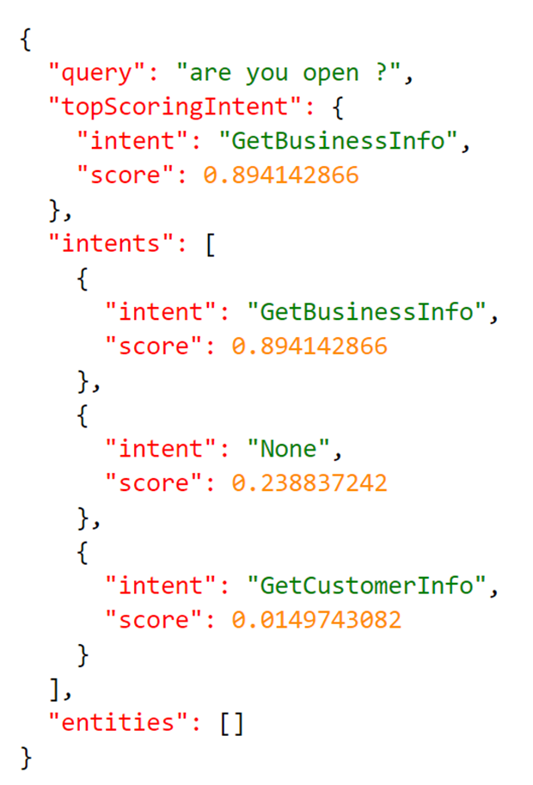

Slide 16
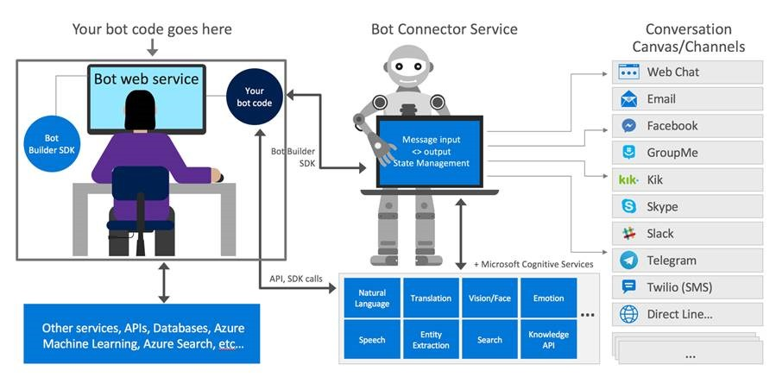
Bot Framework
Bot Builder SDK
Azure Bot Service
Channels

Slide 17
Demo

Slide 18
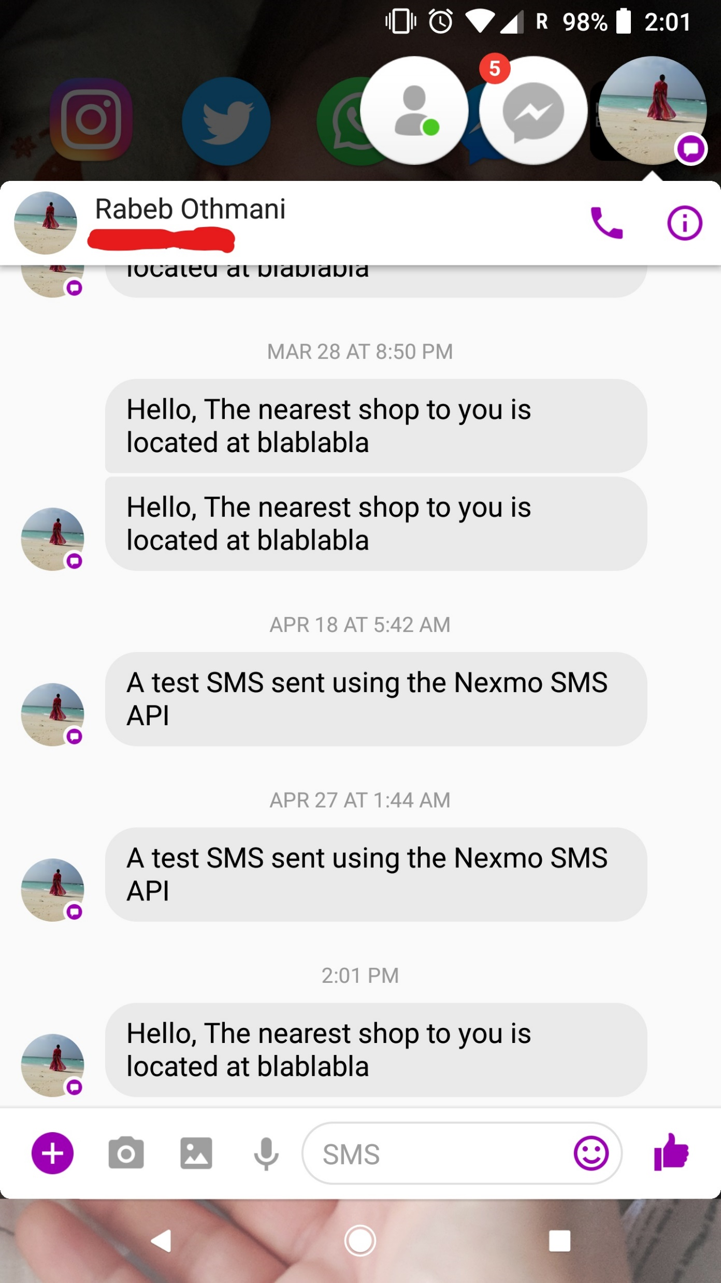
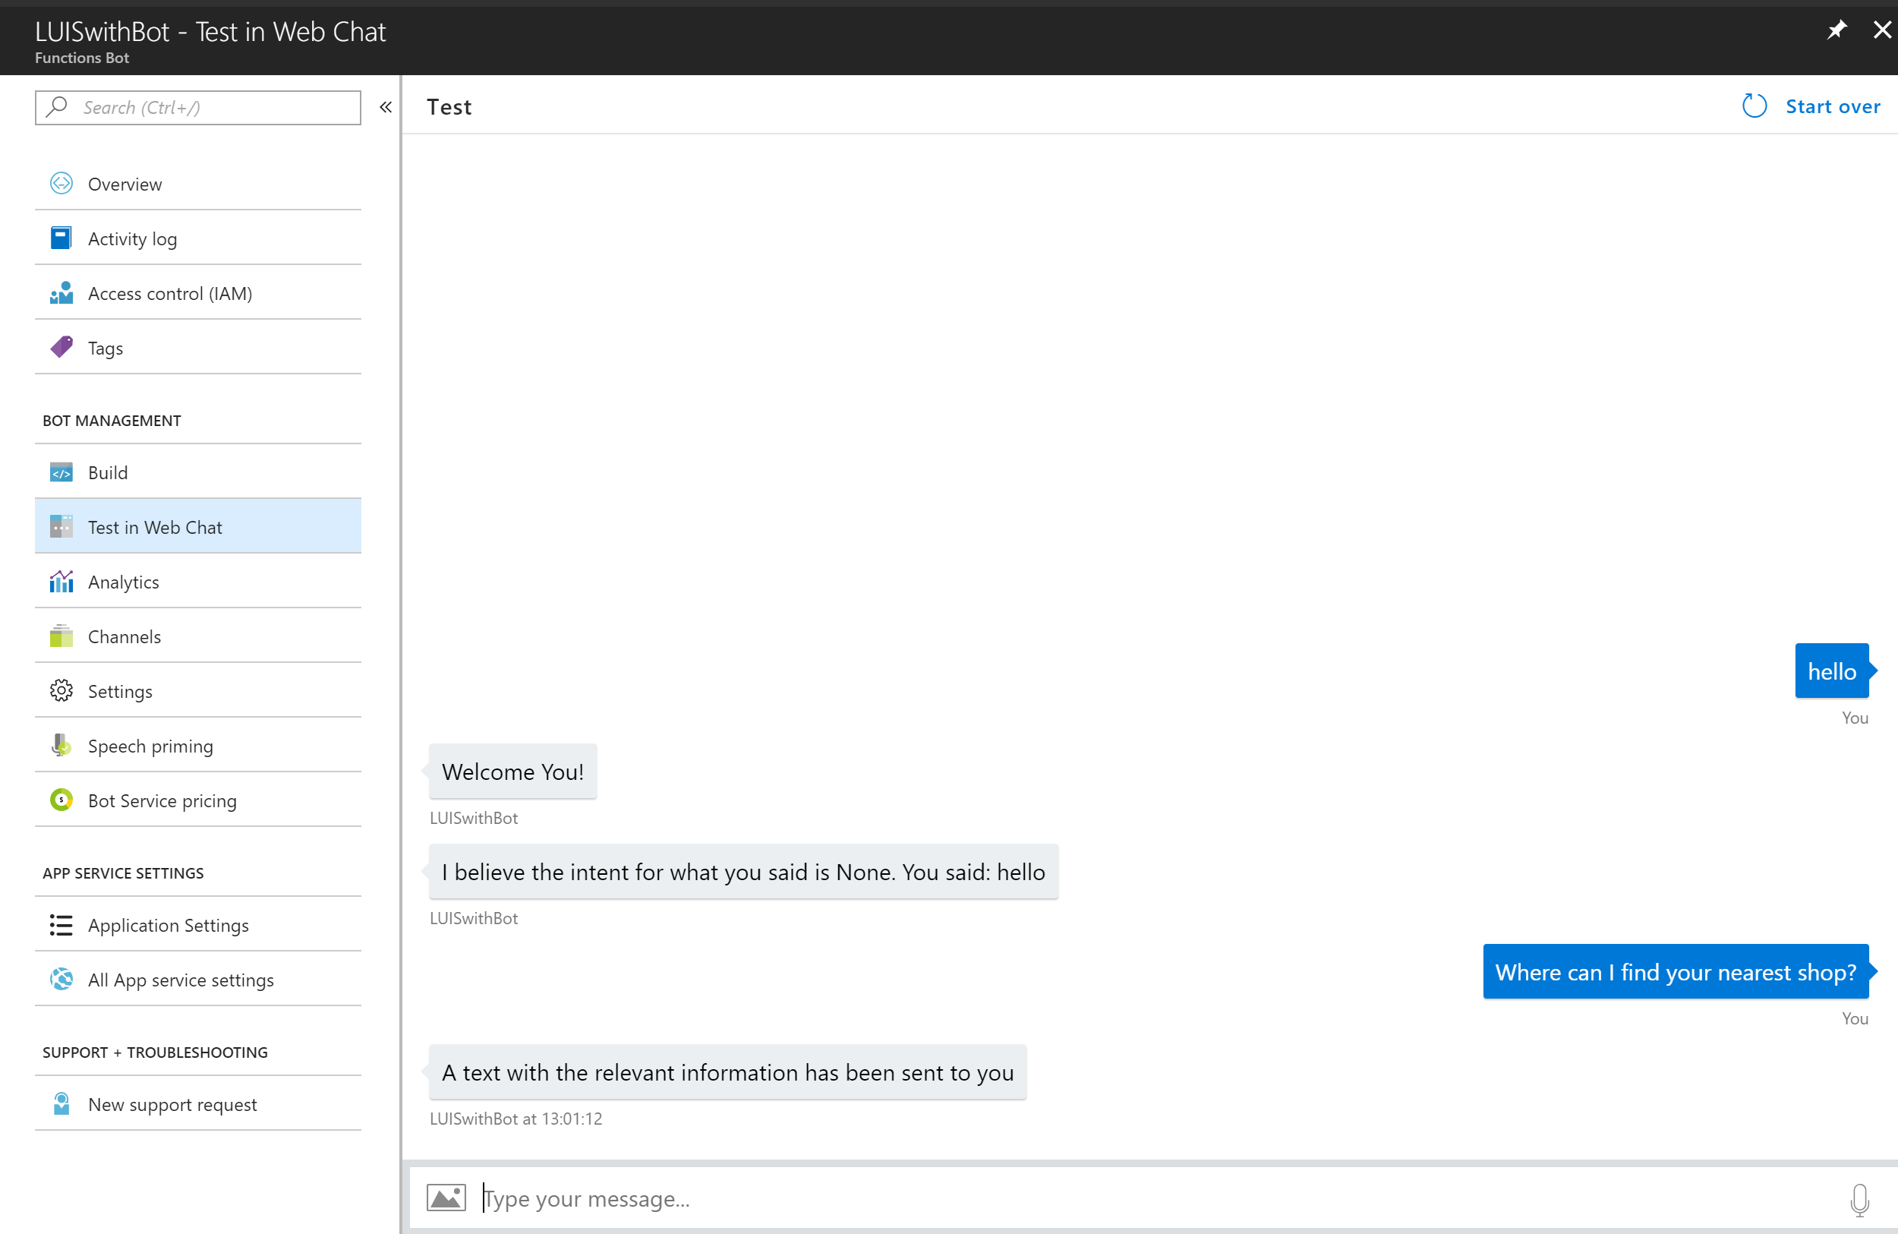

Slide 19
🙏 Thank you for attending my talk 🙏
🌟 You’ve been an awesome audience 🌟
👍 don’t forget to evaluate this session in the DevSum app please👍
😛 If you think I’m amazing & want to tweet about it, please tag my employer @NexmoDev…Kidding😛
🤓 For further questions or feedback, contact me : @Rabeb_Othmani or rabeb.othmani@vonage.com 🤓

